Slide 1
Information and Communication Technology
Introduction to ICT
Data VS Information

Slide 2
Introduction to ICT
Information and communications technology (ICT) is an extensional term for information technology (IT) that stresses the role of unified communications^{[1]} and the integration of telecommunications (telephone lines and wireless signals) and computers, as well as necessary enterprise software, middleware, storage and audiovisual, that enable users to access, store, transmit, understand and manipulate information.

Slide 3
Differences
Data
Information
Data is unprocessed.
ata is independent of information.
Data alone can never be significant.
Information is processed.
Information is dependent on data.
Information can be significant without data.

Slide 4
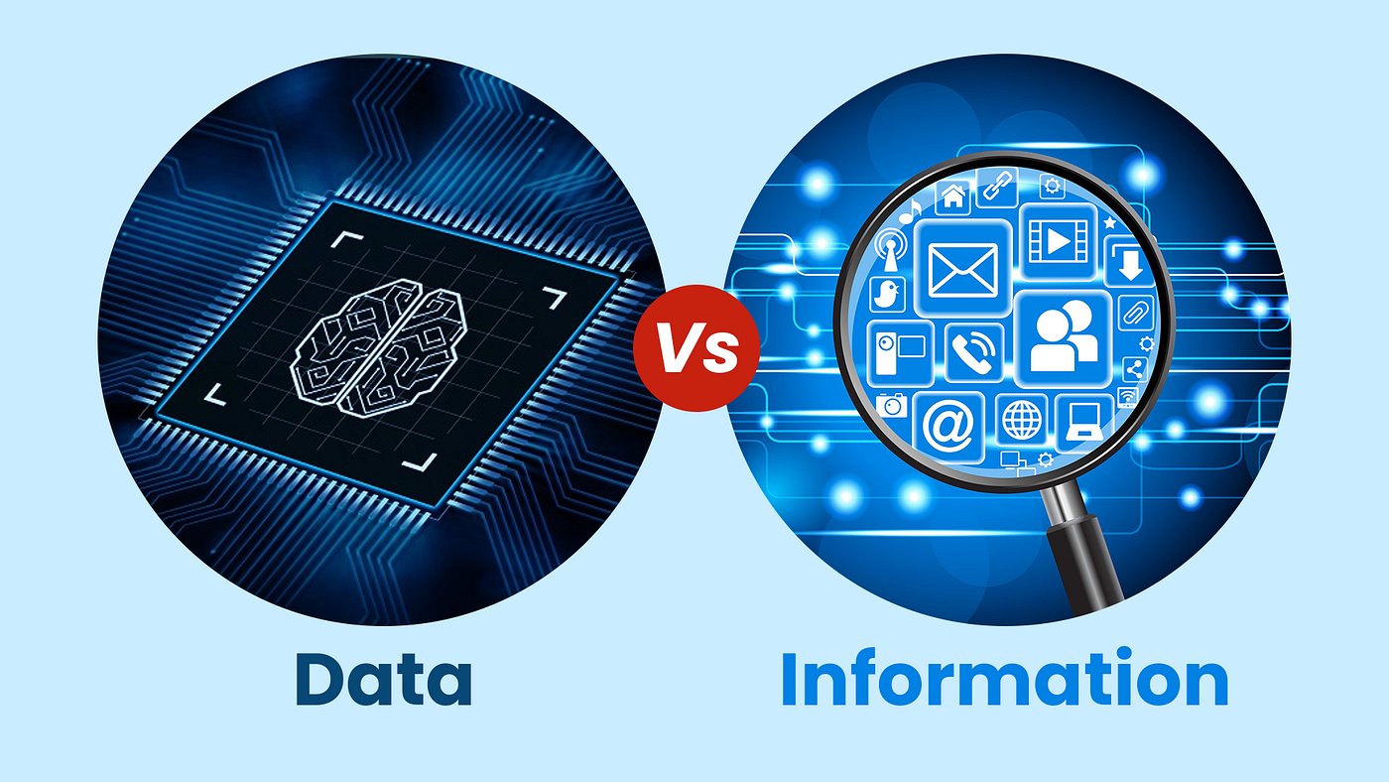
Display 1.1.
Data VS Information

Slide 5
THANK YOU
If you have any queries, feel free to ask.

Slide 6
Aardvark Advertising Inc.
Jane peters
CEO
Jo Whalley
PA
Nathan Sams Creative Director
John Black Sales
Mariam Solberg IT

Slide 7
Auto Layouts
Titles | Bullet Slides
Tables | Organization Charts
Charts | Pictures

Slide 10
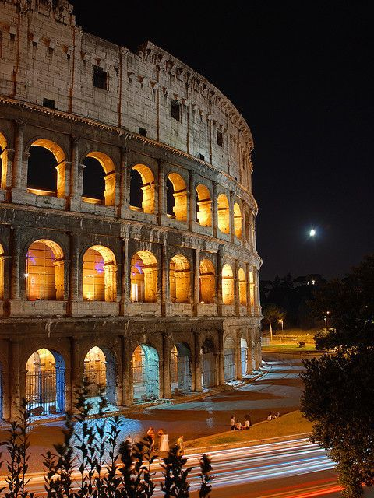
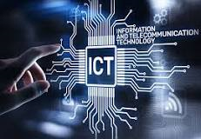
Colosseum at night

Slide 11

ICT

Slide 12
What is Global Warming

Slide 13

The Desert

Slide 14

Mosque

